Slide 1
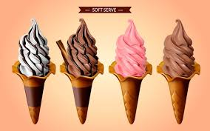
PROJECT ON ENTREPRENURSHIP
DEVELOPMENT OF ICE CREA FACTORY
GUIDED BY
PRESENTED BY
DR. APURBA GIRI (Assistant professor & Head)
AYAN MONDAL(Assistant professor)
DEPT. OF NUTRITION
MUGBERIA GANGADHAR MAHAVIDYALAYA
SOUMEN MANNA
B.VOC (Food processing,6th sem)
DEPT. OF NUTRITION
MUGBERIA GANGADHAR MAHAVIDYALAYA

Slide 2
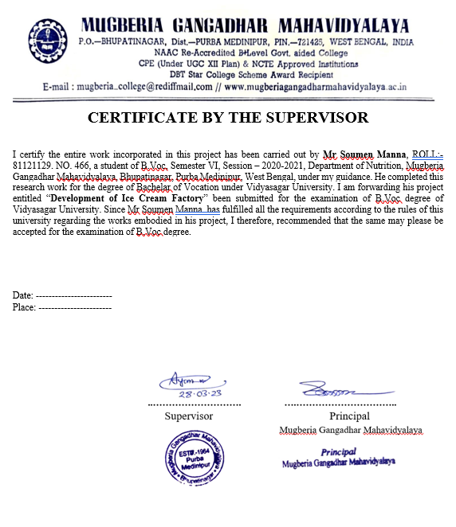
.

Slide 3
ICE-CREAM MANUFACTURING BUSINESS
BUSINESS RESEARCH
INVESTMENT
LICENSES
RAW MATERIAL
MACHINARY & MAN POWER
TARGET COUSTOMERS
PROFIT
PLANT PAYOUT

Slide 4
Business research
The ice cream market in India size reached INR 194.1 Billion in 2022. Looking forward, IMARC Group expects the market to reach INR 508.4 Billion by 2028. where global market growth rate is 4.7% Indian’s annual growth rate is 12.4%, exhibiting a growth rate (CAGR) of 17.5% during 2023-2028.

Slide 5


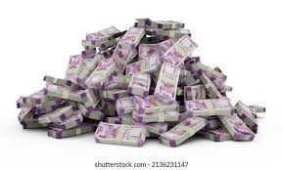
Investment
Small scale:- 15 L
Large scale:- 50-60 L
CAPITAL

Slide 6
licenses
REGISTRATION OF BUSINESS
NOC
GST(GOODS & SERVICE TAX)
FSSAI
SMALL SCALE INDUSTRY LICENSE
REGISTRATION FOR TRADEMARK

Slide 7
Raw material
Milk
Flavoring agent
Stabilizer
Emulsifier
Cone
Cup

Slide 8
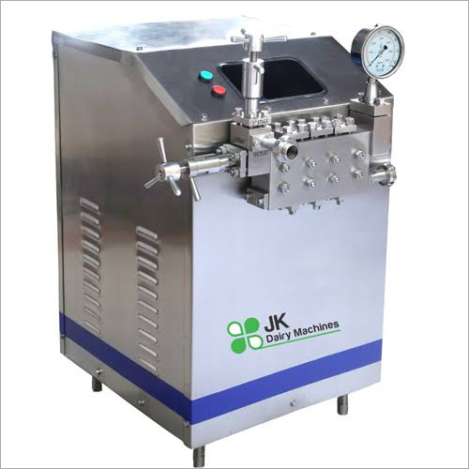
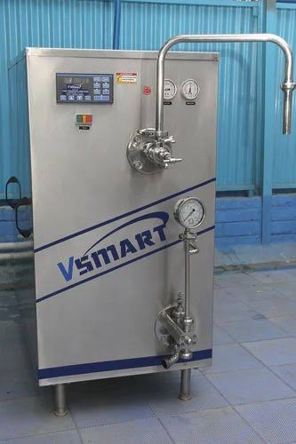
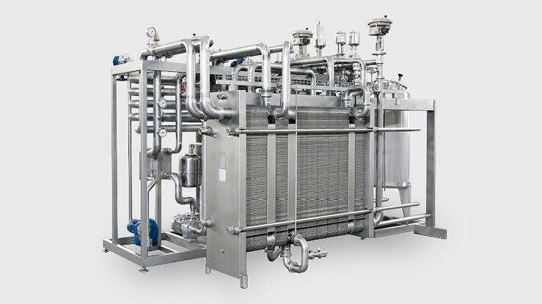
Machinery & man power
Pasteurizer
Homogenizer
Freezer
Hardener
Packaging machine
7-10 Staff
Man power

Slide 9
Processing flow chart
Selection of ingredients
Figuring the mix
Making the mix
Hardening and storage of ice cream
Pasteurizing the mix
Homogenizing the mix
Packaging of ice cream
Cooling and ageing the mix
Freezing the mix

Slide 10
Target coustomers
Wholesalers
School, collage & office canteens
Cafes
Restaurants
Popular hangouts
Fairs
Event planning agencies

Slide 11

Profit
Production:- 5000 Stick
500 L Cup
Profit:- 3-4 Lakhs

Slide 12
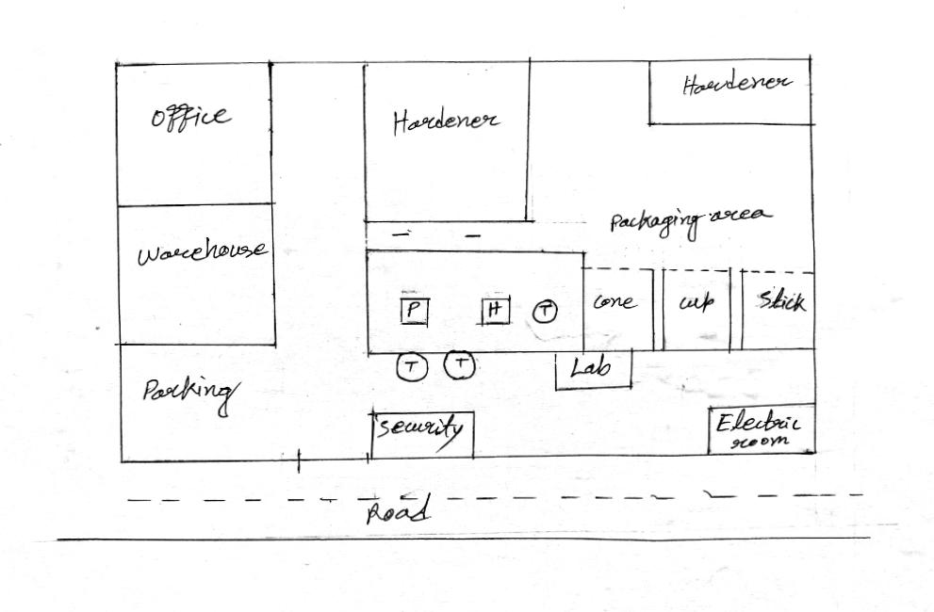
Plant layout

Slide 13
THANK YOU

